Slide 1
Developing An Optimized Hunt/Target Algorithm For The Game Of Battleship
By Kim Scicluna

Slide 2
Rules Of The Game
1) Played on a ten by ten grid
2) Only one shot per turn
3) The algorithm is only notiﬁed if the shot is missed, hit or destroy
4) Ships must have at least one empty cell between them

Slide 3
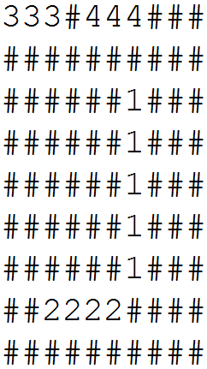
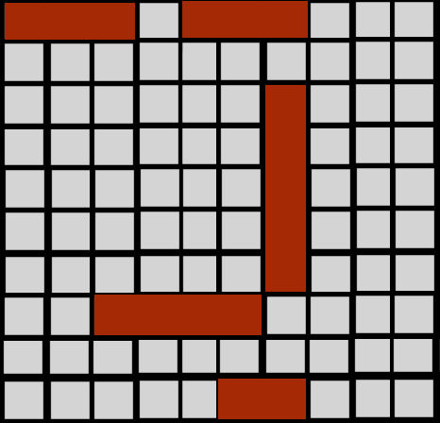
Dataset Used
Raw Text
Parse

Slide 4
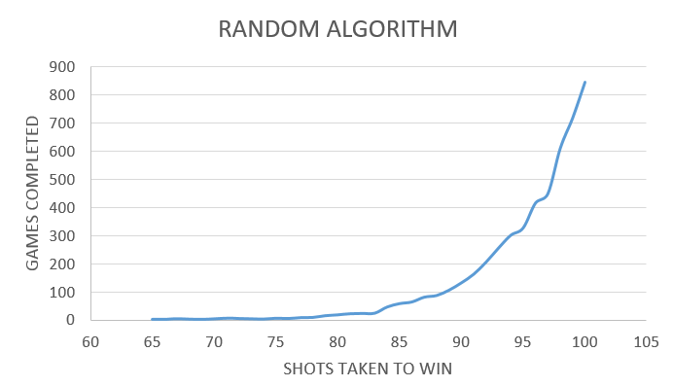
Random Shooting Algorithm
Benchmark of a non-optimal way to play the game.
This algorithm is not efﬁcient at all as its based on pure luck.

Slide 5
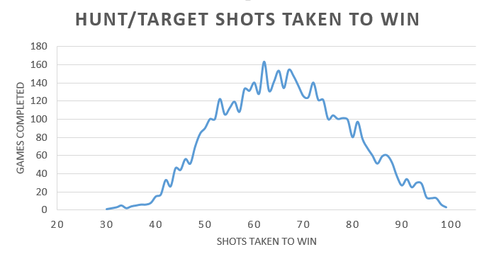
Hunt/Target Algorithm
Optimized version of the random algorithm
Hunting and targeting
Calculates possible adjacent targets around the initial hit cell.
Every hit is added to an array
Calculates possible adjacent targets around every cell in the array

Slide 6
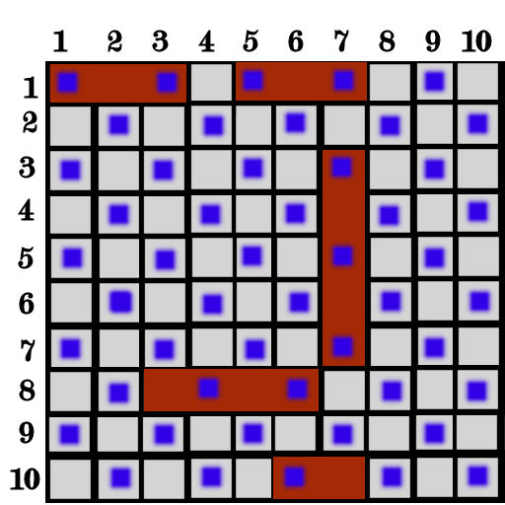
Improved Hunt/Target
Parity system for the hunting stage
Finds the orientation of the ship
Finds the direction it should target

Slide 7
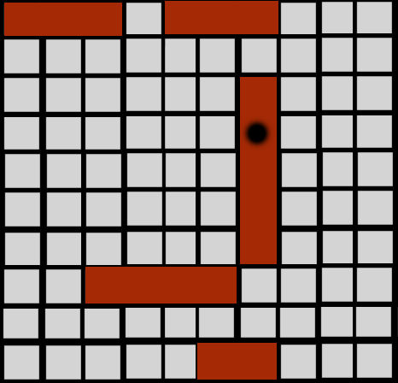
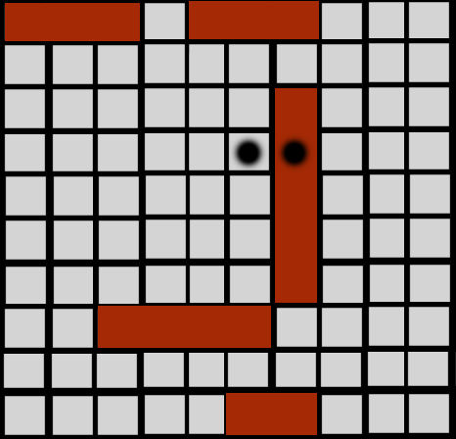
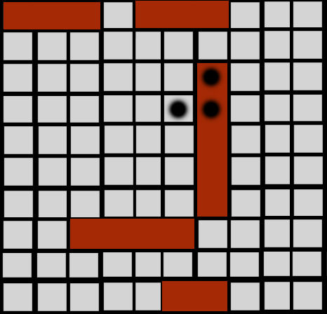

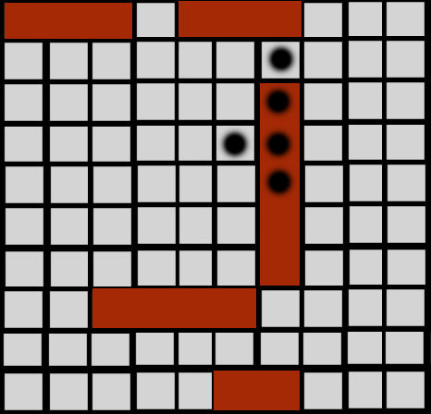


Improved Hunt/Target

Slide 8
Average Number Of Shots Per Game
Random | 95
Hunt Target | 66
Improved Hunt Target | 49

Slide 9
Total Number Of Shots Per Simulation
5000 games each simulation
Same data set
Random | 476763
Hunt Target | 331255
Improved Hunt Target | 249210

Slide 10
Thanks For Your Time

